Slide 1
Final Project
K.V.N.Sowjanya Lakshmi
3/21/2024 Annual Review

Slide 2
PROJECT TITLE
Unveiling the Secrets of Key Logging
3/21/2024 Annual Review

Slide 3
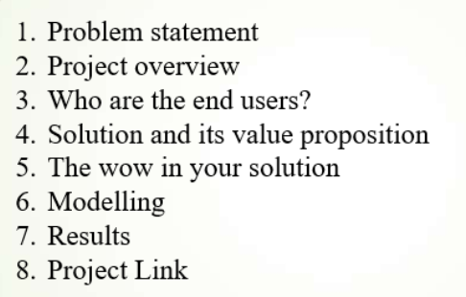


AGENDA
3/21/2024 Annual Review

Slide 4
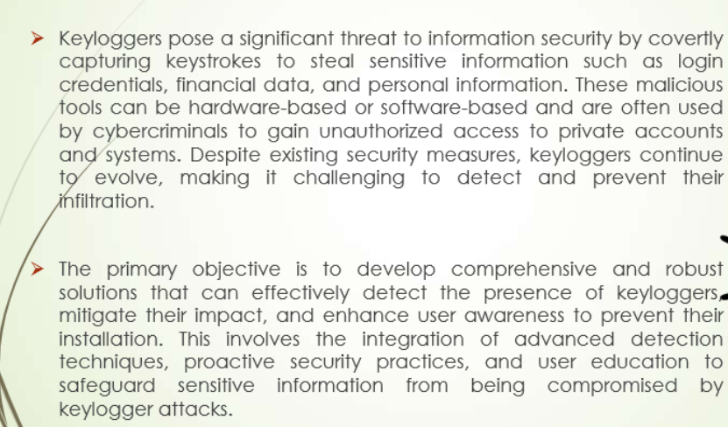

PROBLEM STATEMENT
3/21/2024 Annual Review

Slide 5

PROJECT OVERVIEW
1. Objective:
- Monitor user activity for security and control purposes.
2. Legal and Ethical Considerations:
- Ensure compliance with privacy laws and ethical standards.
3. Technical Development:
- Design and implement the keylogger.
- Capture keystrokes, store, and transmit data securely.
4. Security Measures:
- Protect captured data with encryption and access controls.
5. Testing and Debugging:
- Conduct thorough testing in various environments.
- Identify and fix bugs for reliable performance.
6. Deployment and Maintenance:
- Deploy to target systems.
- Provide regular updates and support.
3/21/2024 Annual Review

Slide 6

WHO ARE THE END USERS?
1. **IT Security Teams:**
- Monitor and detect unauthorized access or suspicious activity within an organization.
2. **Parents:**
- Supervise and ensure safe internet usage by children.
3. **Employers:**
- Track employee activity for productivity and security purposes in the workplace.
4. **Law Enforcement Agencies:**
- Investigate cybercrimes and gather digital evidence.
5. **Researchers:**
- Study user behavior and interaction with systems for academic or commercial research.
6. **Individuals:**
- Personal use for monitoring and securing their own devices.
3/21/2024 Annual Review

Slide 7

YOUR SOLUTION AND ITS VALUE PROPOSITION
**Solution:**
- **Comprehensive Keylogging Software**:
- **User Activity Monitoring**: Tracks and records keystrokes.
- **Data Security**: Ensures encrypted data storage and transmission.
- **Real-time Alerts**: Provides immediate notifications of suspicious activities.
- **User-friendly Interface**: Easy setup and management.
**Value Proposition:**
- **Enhanced Security**: Protects against unauthorized access and potential threats.
- **Increased Productivity**: Allows employers to monitor and improve employee efficiency.
- **Parental Control**: Enables parents to safeguard their children's online activities.
- **Crime Investigation**: Assists law enforcement in gathering digital evidence.
- **Behavioral Insights**: Provides researchers with valuable data on user behavior.
3/21/2024 Annual Review

Slide 8

THE WOW IN YOUR SOLUTION
**1. **Advanced AI-Powered Analytics**:
- **Intelligent Threat Detection**: Uses AI to identify and flag unusual or suspicious activity patterns, enhancing security beyond basic keylogging.
**2. **Seamless Integration**:
- **Cross-Platform Compatibility**: Works effortlessly across multiple operating systems (Windows, macOS, Linux) and devices (desktops, laptops, mobile devices).
**3. **Real-time Visualization**:
- **Dynamic Dashboards**: Provides real-time visual analytics and reports, making it easy to monitor and interpret data at a glance.
**4. **Stealth Mode**:
- **Invisible Operation**: Runs undetected in the background, ensuring users remain unaware, which is crucial for security and monitoring effectiveness.
**5. **Compliance and Ethical Assurance**:
- **Built-in Legal Frameworks**: Ensures compliance with regional and international privacy laws, providing peace of mind regarding ethical use.
3/21/2024 Annual Review
8

Slide 9
MODELLING
**1. **AI-Powered Analytics**:
- Intelligent Threat Detection
**2. **Seamless Integration**:
- Cross-Platform Compatibility
**3. **Real-time Visualization**:
- Dynamic Dashboards
**4. **Stealth Mode**:
- Invisible Operation
**5. **Compliance and Ethical Assurance**:
- Built-in Legal Frameworks
.
3/21/2024 Annual Review
9

Slide 10
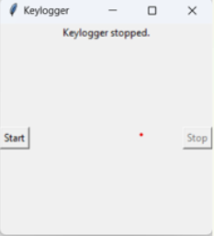
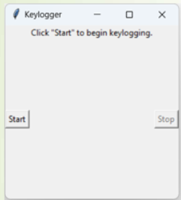
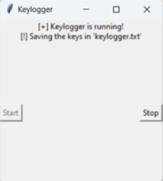

RESULTS
3/21/2024 Annual Review
10

Slide 11
PROJECT LINK
https://github.com/SowjanyaKolisetty/APSSDC_PROJECT.git

